Slide 1

Telecom Churn Prediction
Author: Shaldon Williams

Slide 2
Contents
A Little About the Author
Problem Statement
About the Training Data
Exploring the Data
Hyperparameters and Chosen Model
Conclusions
Data Preparation and Cleaning
Further Model Testing

Slide 3




A Little About the Author
Shaldon Williams
Certificate in Network Engineering
Bachelor in Information Technology
Quality Assurance and Report Designer for a Student Management Software Company
New job opportunities
New directions for current job
Expand my current skill set

Slide 4



Problem – Why should we analyse churn?
Revenue Impact
Identifying Pain Points
Brand Reputation
Acquiring new customers costs significantly more than retaining existing ones.
Churn analysis reveals why customers leave, highlighting areas for improvement in your product, service, pricing, or customer experience.
Consistent customer churn can damage a company's reputation. Dissatisfied customers may share negative experiences, influencing potential customers and harming the brand image.

Slide 5



About the Training Data
Categorical Data Encoding:
The columns "REGION," "TENURE," "MRG," and "TOP_PACK" contain categorical data. Proper encoding (e.g., one-hot encoding) may be necessary for certain machine learning algorithms.
Data Distribution:
Analyzing the distribution of numerical features (e.g., using histograms) could provide insights into the data's characteristics and help identify potential normalization or scaling needs.
Feature Correlation:
Investigating the correlation between different features, especially numerical ones, can help identify relationships and potential multicollinearity issues.
Data Quality and Accuracy:
Perform a thorough data quality check to ensure accuracy, consistency, and reliability. This includes checking for duplicate records, anomalies, and discrepancies.
2154048 Unique Client IDs
Potential Issues with the Data
1750062 Retained Clients
403986 Churned Clients
18.75% Churn Rate

Slide 6
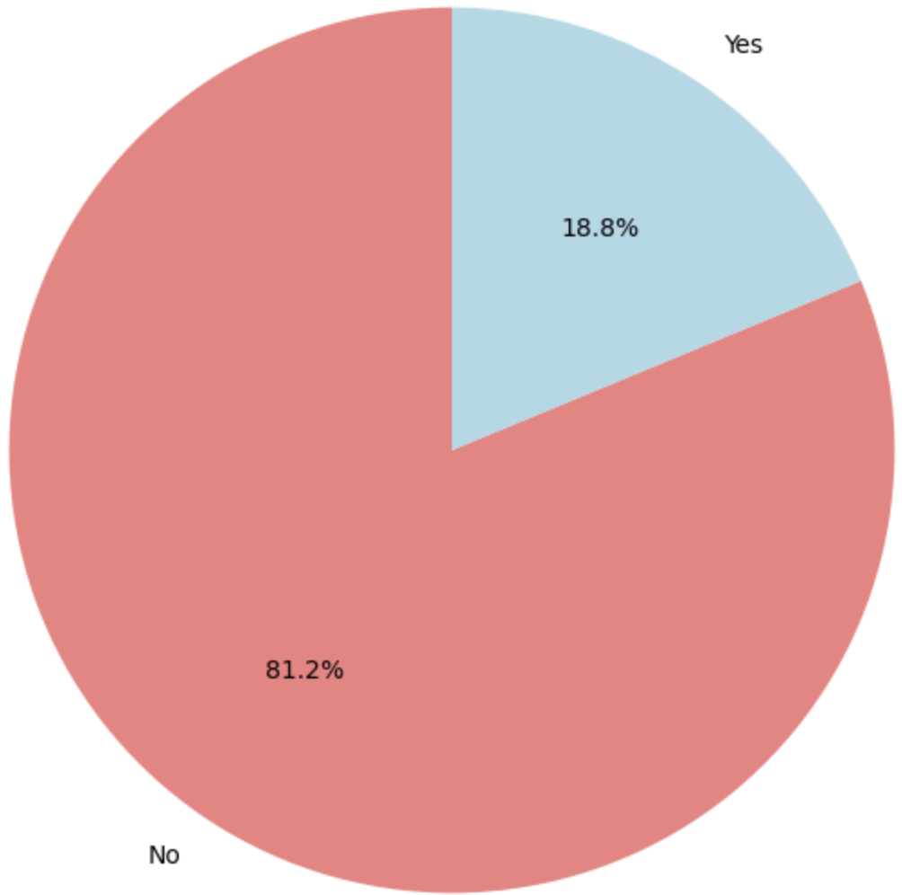
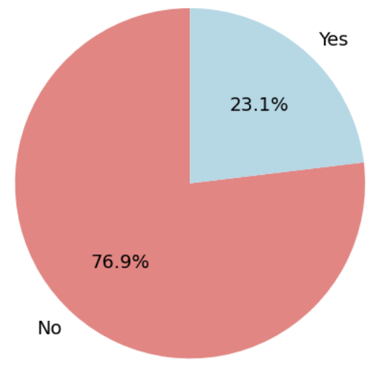
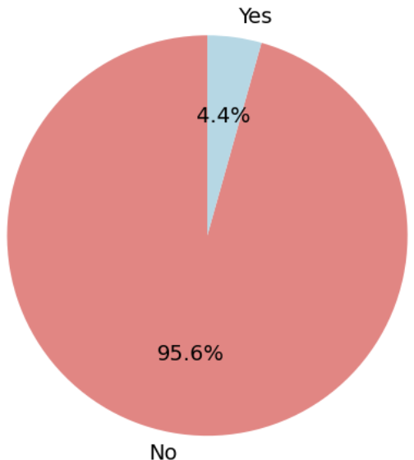
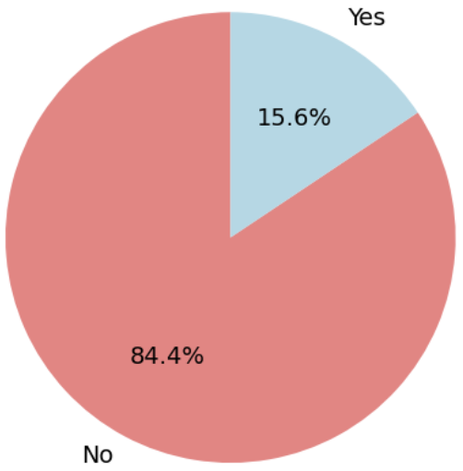
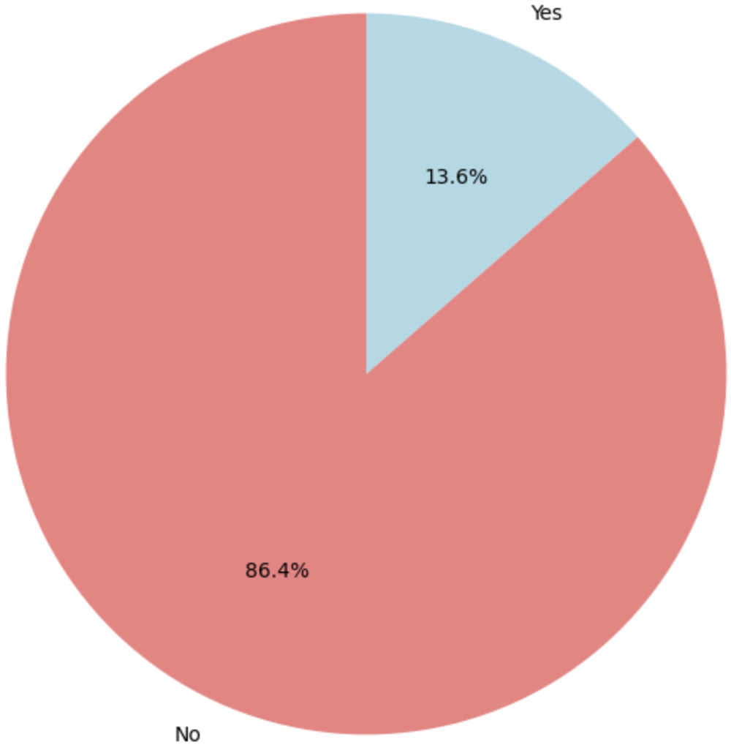
Exploring the Data
Over all Churn Across the Training Data
A few features had very low values
Some categorical features were more distributed
Churn Distribution for Tenure
Churn Distribution for Region
Churn Distribution for Regularity
Churn Distribution for Montant

Slide 7
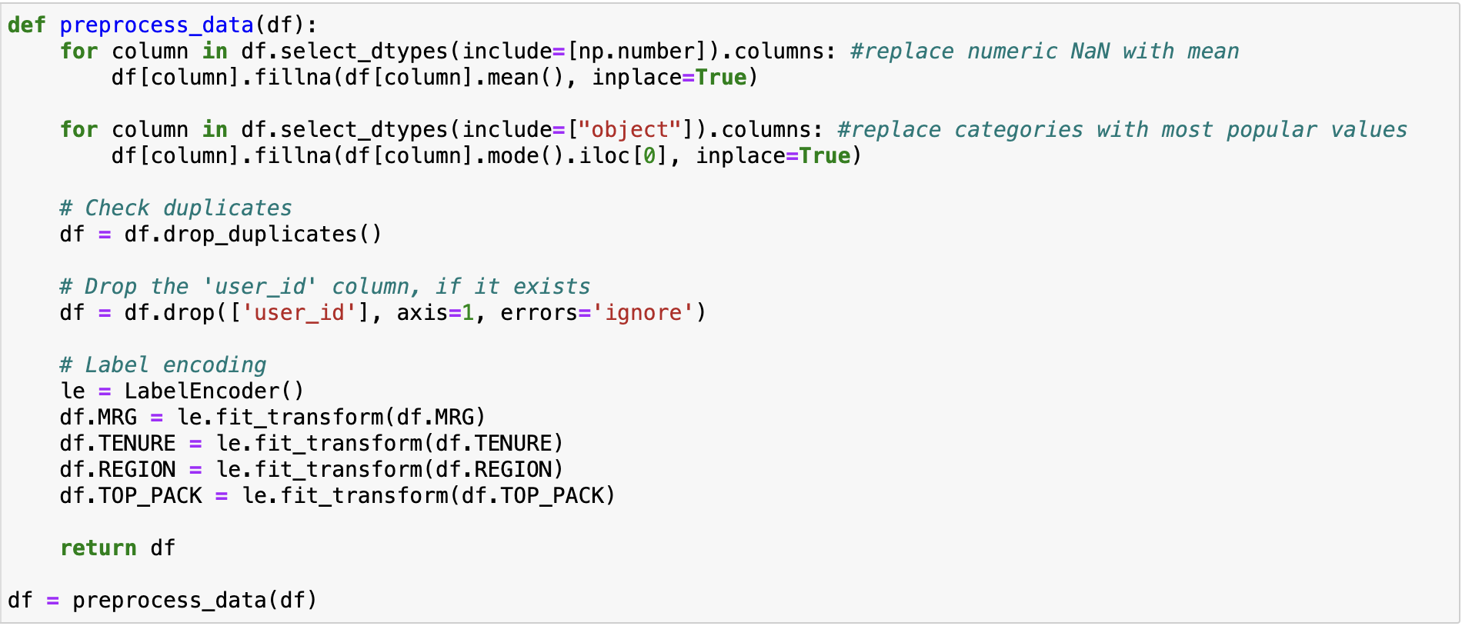
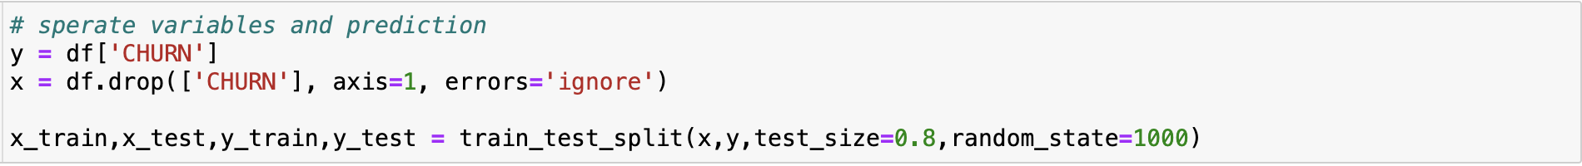
Data Prep and Cleaning
Used mean to complete Numerical features
Converted Objects into Numerical features
Dropped all duplicates
Dropped the "user_id" feature
Encoded most categorical data into Numerical
Splitting Data in preparation for modeling and training

Slide 8
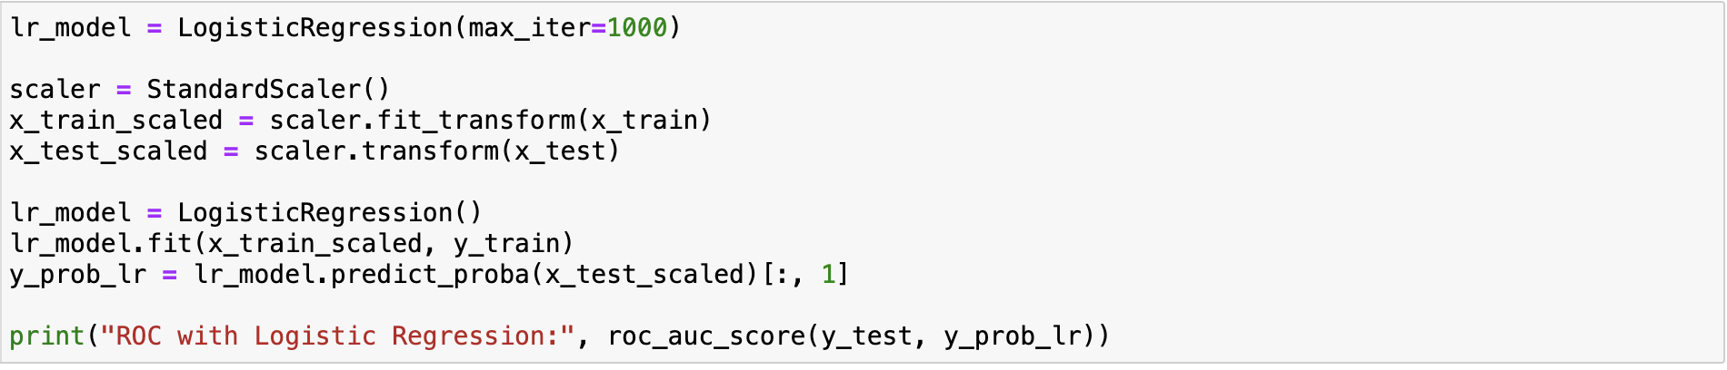
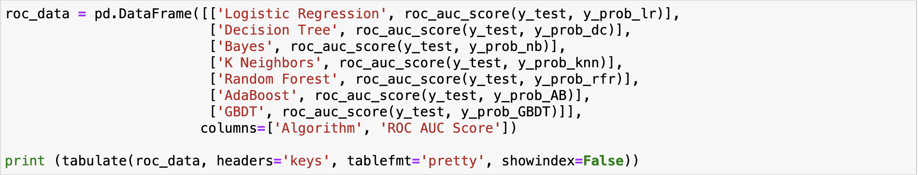
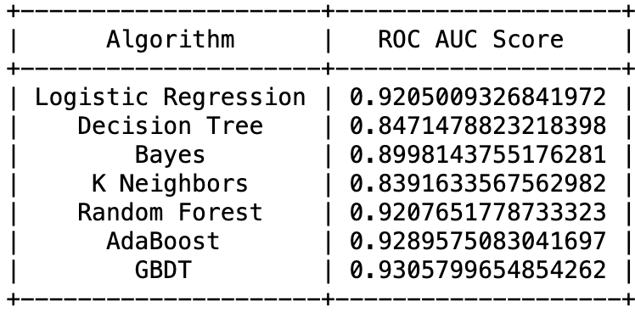
Accuracy of the Algorithms
Logistic Regression
Decision Tree
Bayes
K Neighbors
Random Forest
AdaBoost
Gradient Boost

Slide 9
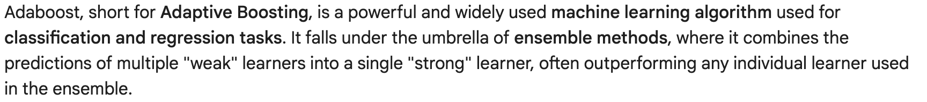
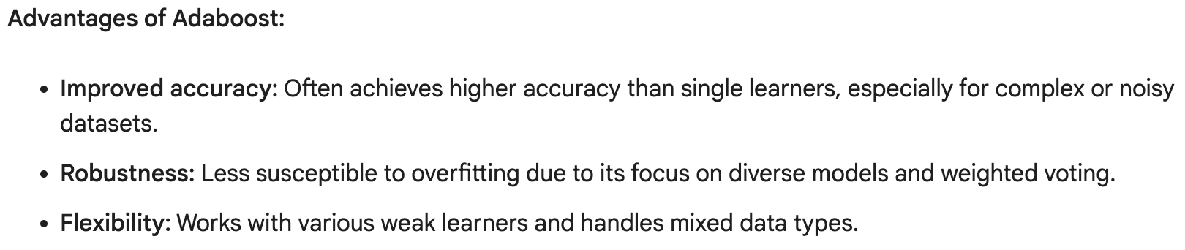
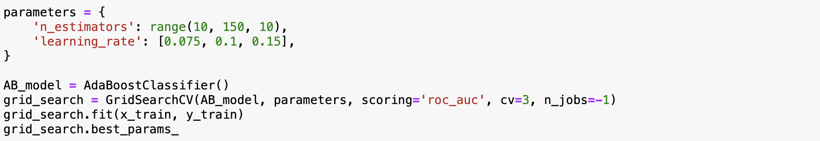
Hyper Parameters and the Chosen Model
Ada Boost

Slide 10
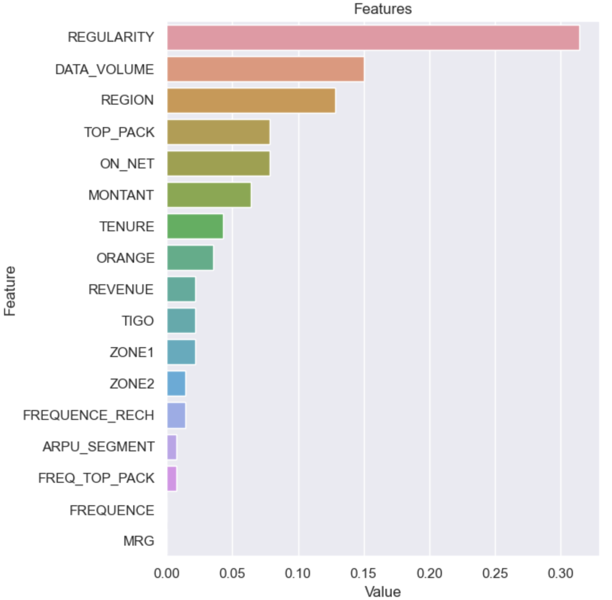
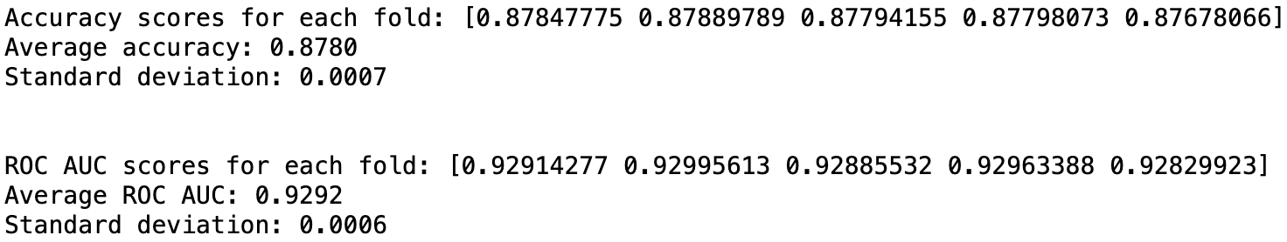
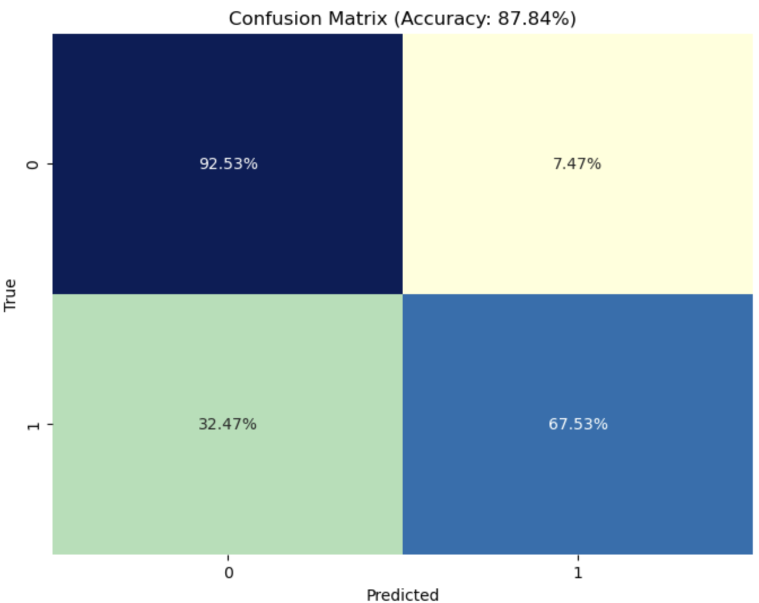
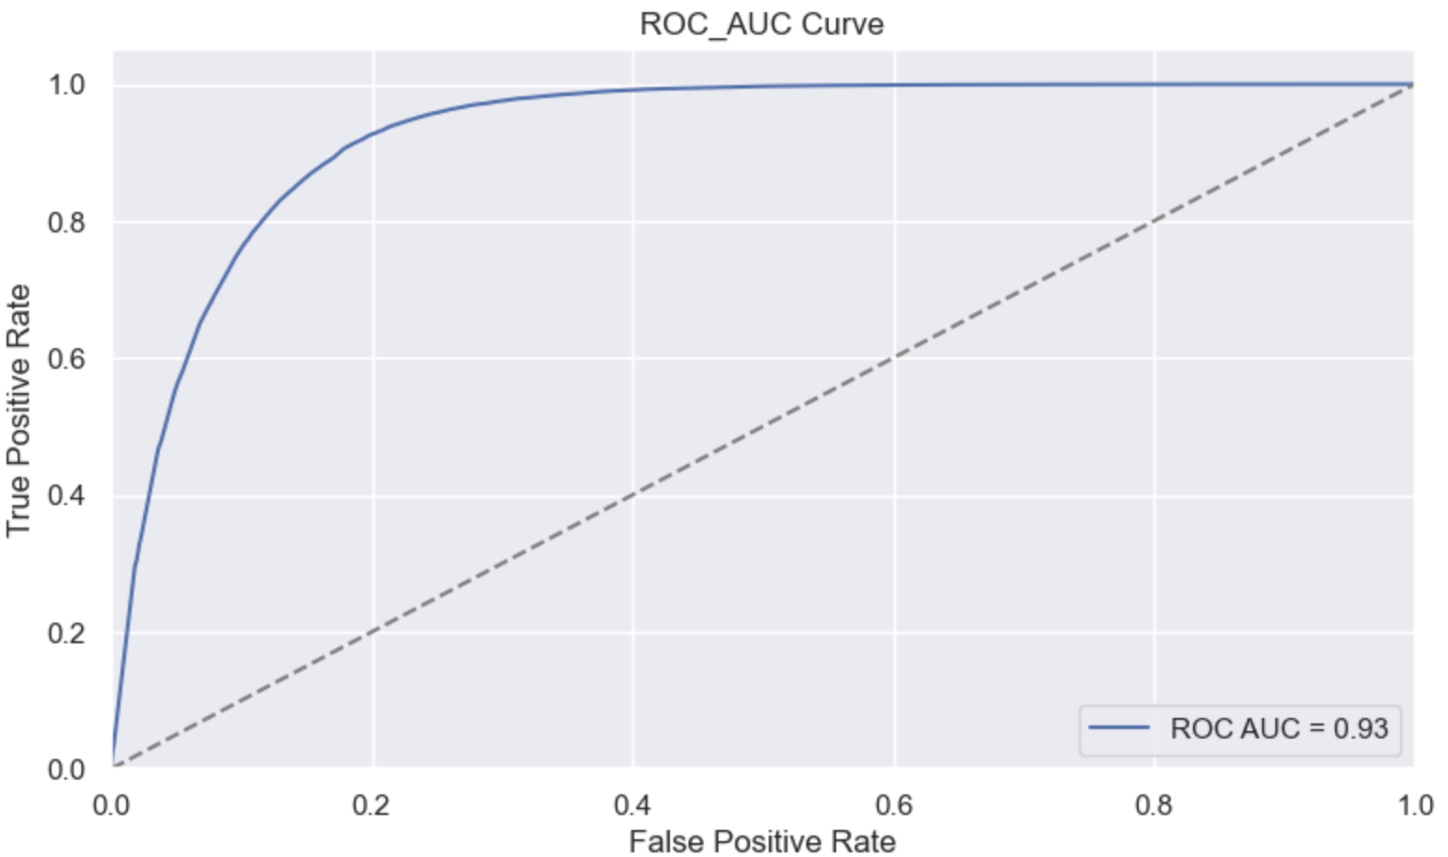
Further Model Testing
Cross-validation

Slide 11
Conclusions
Conclusion
The following features should be looked at when looking to retain customers.
REGULARITY: number of month the customer is active for 90 days
REGION: customer location
MONTANT: the amount of money the user has paid to the company
DATA_VOLUME: the amount of data used by the customer
Insights
After training and evaluating our models, we found that the AbaBoost model had the best performance.
Future Steps
While in this case AdaBoost was shown to work well with this data, further testing is required.
There were four other models that performed almost as well, but were not chosen, but with more training could prove to be a better model.
Look at using different datasets from the same company.
Other datasets may lack important features.

